Slide 1
Greedy Algorithms

Slide 2
贪心算法仅在局部最优等于全局最优时有效。贪心算法不保证能找到最优解。然而，它通常会产生非常接近最优解的解决方案（启发式方法），而且速度很快

Slide 3


Greedy Algorithms
活动S = { a₁, a₂, …, a_{n} } that wish to use a resource (e.g. a classroom). Each a_{i} takes place during a time interval [s_{i}, f_{i}).
Activities a_{i} and a_{j} are compatible if s_{i} ≥ f_{j} or s_{j} ≥ f_{i} (i.e. their time intervals do not overlap).
Select a maximum-size subset of mutually compatible activities.
Assume: f₁ ≤ f₂ ≤ … ≤ f_{n–1} ≤ f_{n}
〖Example〗
i | 1 | 2 | 3 | 4 | 5 | 6 | 7 | 8 | 9 | 10 | 11
s_{i} | 1 | 3 | 0 | 5 | 3 | 5 | 6 | 8 | 8 | 2 | 12
f_{i} | 4 | 5 | 6 | 7 | 9 | 9 | 10 | 11 | 12 | 14 | 16

Slide 4
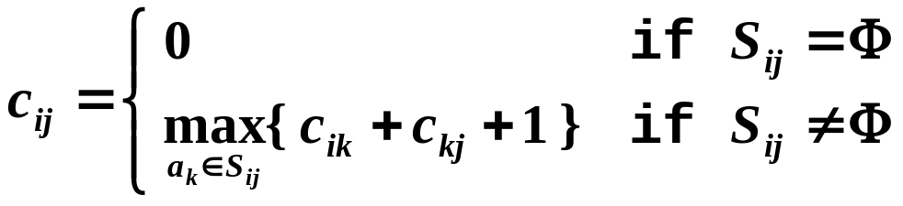
Greedy Algorithms
☞ 动态规划解法
a₁ a₂ … a_{i} … a_{k} … a_{j} … a_{n}
S_{ij}
O( N² )
☞ Greedy Rule 1: Select the interval which starts earliest如果最早的那个持续了一天就完蛋
☹

Slide 5
Greedy Algorithms
☞ Greedy Rule 2: Select the interval which is the shortest (0~12; 12~24; 11~13，完蛋)
☹
☺
☞ Greedy Rule 3: Select the interval with the fewest conflicts with other remaining intervals (but not overlapping the already chosen intervals) 如果选择不唯一，贪心一般都是错的
☹
☺
☞ Greedy Rule 4: Select the interval which ends first (but not overlapping the already chosen intervals) 结束最早，最早释放
Resource become free as soon as possible
☺

Slide 6
Greedy Algorithms
Correctness:
① Algorithm gives non-overlapping intervals 先证明可行
② The result is optimal 证明最优
【Theorem】 Consider any nonempty subproblem S_{k}, and let a_{m} be an activity in S_{k} with the earliest finish time. Then a_{m} is included in some maximum-size subset of mutually compatible activities of S_{k}. 最优子结构
Proof:
Let A_{k} be the optimal solution set, and a_{ef} is the activity in A_{k} with the earliest finish time.
If a_{m} and a_{ef} are the same, we are done! Else ……
replace a_{ef} by a_{m} and get A_{k}’.
Since f_{m} ≤ f_{ef} , A_{k}’ is another optimal solution.
Implementation:
① Select the first activity; Recursively solve for the rest.
② Remove tail recursion by iterations.
O( NlogN )
Notes:
必然存在一个最优解，包含了最早结束的那个任务 (反证法，若不存在，则可以把某个最优解的最早任务换成最早结束的那个，构造处一个新的最优解)

Slide 7
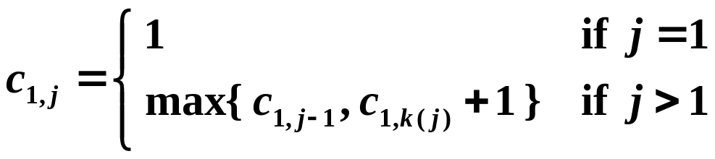
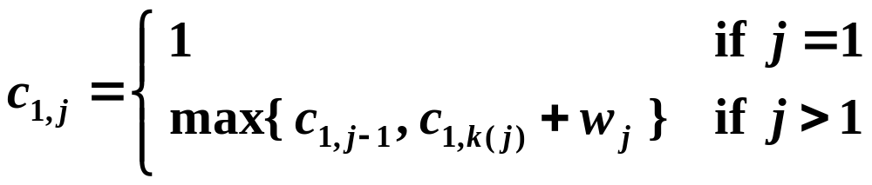
☞ Another Look at DP Solution
where c_{1,j} is the optimal solution for a₁ to a_{j} , and a_{k(j)} is the nearest compatible activity to a_{j} that is finished before a_{j} .
If each activity has a weight …
Q1: Is the DP solution still correct? Yes
Q2: Is the Greedy solution still correct? No

Slide 8
Greedy Algorithms
Elements of the Greedy Strategy 证明过程
1. Cast the optimization problem as one in which we make a choice and are left with one subproblem to solve.
2. Prove that there is always an optimal solution to the original problem that makes the greedy choice, so that the greedy choice is always safe.
3. Demonstrate optimal substructure by showing that, having made the greedy choice, what remains is a subproblem with the property that if we combine an optimal solution to the subproblem with the greedy choice we have made, we arrive at an optimal solution to the original problem.
Beneath every greedy algorithm, there is almost always a more cumbersome dynamic-programming solution

Slide 9
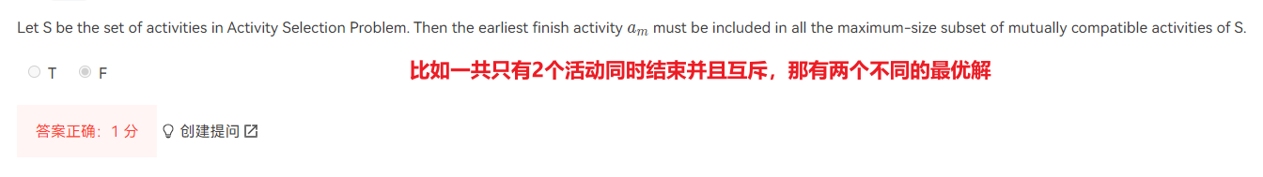

Slide 10
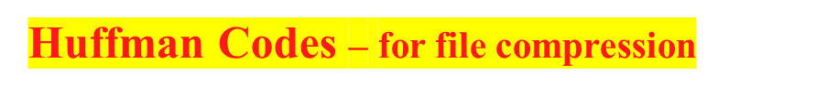
Greedy Algorithms
节省编码空间，出现多的码用长一点
➢ frequency ::= number of occurrences of a symbol.
In string aaaxuaxz , f(a) = 4, f(u) = 1, f(x) = 2, f(z) = 1.
The size of the coded string can be reduced using variable-length codes, for example, a = 0, u = 110, x = 10, z = 111.
00010110010111

Slide 11
Greedy Algorithms
➢ If character C_{i} is at 深度 d_{i} and occurs f_{i} times, then the cost of the code = Σ d_{i} f_{i} .
0
1
Cost ( aaaxuaxz → 0000001001001011 )
= 2×4 + 2×1 + 2×2 + 2×1 = 16
0
1
0
1
a
u
x
z
1
Cost ( aaaxuaxz → 00010110010111 )
= 1×4 + 3×1 + 2×2 + 3×1 = 14
0
1
0
0
1
霍夫曼树
总节点数 = 2×对象数-1
a
x
u
z
Notes:
所有节点都在叶节点上，且频率越高离根节点越近

Slide 12
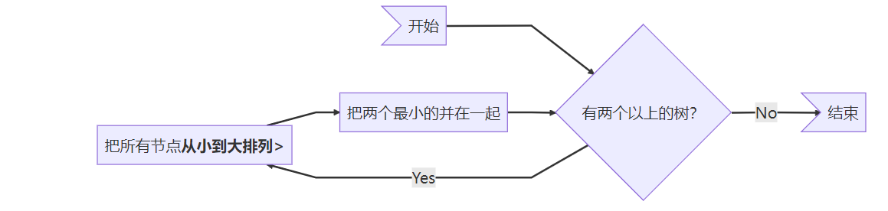
最小堆priorheap，C为节点数
T = O( ClogC )
每轮先排序，将最小的两个合并，和作为父节点，进入下一轮

Slide 13
Greedy Algorithms
〖Example
过程动画〗
C_{i}
a
e
i
s
t
sp
nl
f_{i}
10
15
12
3
4
13
1
a
e
i
s
t
sp
nl
: 111
: 10
: 00
: 11011
: 1100
: 01
: 11010
t
4
8
i
12
4
e
15
sp
13
a
10
58
e
15
a
10
18
a
10
sp
13
e
15
25
i
12
nl
1
e
15
s
3
i
12
25
i
12
a
10
e
15
s
3
e
15
sp
13
33
t
4
t
4
18
sp
13
sp
13
nl
1
i
12
0
1
nl
1
s
3
t
4
4
8
a
10
i
12
sp
13
25
i
12
33
sp
13
e
15
8
18
a
10
0
1
0
1
nl
1
t
4
4
i
12
sp
13
s
3
e
15
18
t
4
8
4
a
10
0
1
nl
1
s
3
8
t
4
a
10
nl
1
4
s
3
Cost = 3×10 + 2×15
+ 2×12 + 5×3
+ 4×4 + 2×13
+ 5×1
= 146
0
1
t
4
4
nl
1
s
3
0
1
nl
1
s
3

Slide 14
Greedy Algorithms
Correctness:
① The greedy-choice property
【Lemma】 Let C be an alphabet in which each character c ∈ C has frequency c.freq. Let x and y be two characters in C having the lowest frequencies. Then there exists an optimal prefix code for C in which the codewords for x and y have the same length and differ only in the last bit.设x,y为两个最小频的对象，则必然存在一个最优解，xy都在同一层，且都在最深层(同样反证)
T
T'
x
a
y
b
a
b
x
y
Cost( T' ) ≤ Cost( T )

Slide 15
Greedy Algorithms
② The optimal substructure property
【Lemma】 Let C be a given alphabet with frequency c.freq defined for each character c ∈ C. Let x and y be two characters in C with minimum frequency. Let C' be the alphabet C with a new character z replacing x and y, and z.freq = x.freq + y.freq. Let T' be any tree representing an optimal prefix code for the alphabet C'. Then the tree T, obtained from T' by replacing the leaf node for z with an internal node having x and y as children, represents an optimal prefix
code for the alphabet C.一个最优解，将其拆为两个，两个都作为子节点，最优性不会丢失
T'
T
a
a
b
z
b
optimal
x
y
optimal
By contradiction.

